Slide 1

Neuromorphic engineering: computational neuroengineering module
Mazzoni@Bionics 2025-2026

Slide 2

Neuronal Models

Slide 3
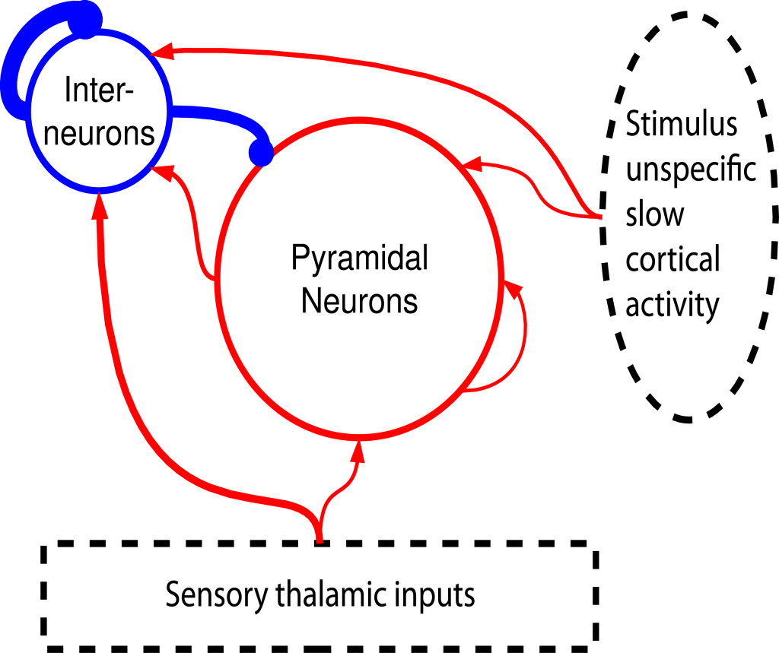
Introducing interaction:
Cortical recurring networks
4000 Excitatory neurons
1000 Inhibitory neurons
Sparse random connection (p=0.2)
Strong inhibition
.
Inhib.
Excitatory.

Slide 4
Introducing interaction:
Cortical recurring networks
4:1 excitatory/inhibitory ratio and strong inhibition combine to achieve excitatory/inhibitory
balance
4000 Excitatory neurons
1000 Inhibitory neurons
Sparse random connection (p=0.2)
Strong inhibition
.
Inhib.
Excitatory.

Slide 5
Introducing external stimuli
4000 Excitatory neurons
1000 Inhibitory neurons
Sparse random connection (p=0.2)
Strong inhibition
Sensory thalamic inputs
(stronger on Inhibitory neurons)
Stimulus unspecific slowly varying inputs modeling ongoing cortical fluctuations.
Inhib.
Excitatory
Each thalamic input is injected many times - each time with a different ongoing activity.

Slide 6
Introducing external stimuli
Inhib.
Excitatory
“Ongoing activity” cortical inputs
Ornstein Uhlenbeck process
“Sensory” thalamic inputs
Mazzoni et al. PLoS Comp Biol 2008
Mazzoni et al. Neuroimage 2010
Mazzoni et al J Physiol 2012

Slide 7

Interlude: noise

Slide 8
Interlude: noise
It’s not possible to estimate the temporal structure of spontaneous cortical activity by measuring the firing of large (>10^3) pools of neurons – extracellular signals show a 1/f^2 spectrum (due to different size of neurons activated in phase)

Slide 9
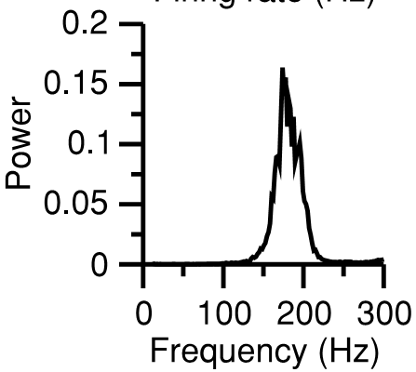
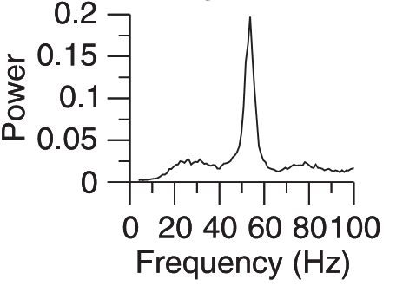
Consequences of interactions
I
I
P
E
Input
Input
I
P
E
Oscillations in the 30-150 Hz range – depending on the inhibition/excitation balance
Brunel-Wang 2003
Input

Slide 10
Consequences of interactions
Purely inhibitory network:
1- neurons are silent
2- external input activates neuron
3 – neurons self-inhibit
4- neurons are silent-> back to step 1
Oscillation is fast
I
I
P
E
Input
Input
I
P
E
Oscillations in the 30-150 Hz range – depending on the inhibition/excitation balance
Brunel-Wang 2003
Input

Slide 11
Consequences of interactions
Excitatory-inhibitory network:
1- E and I neurons
are silent
2- external input activates E neurons
3 – E neurons trigger I neurons activation: both sets are active
4- I neurons inhibit E neurons: only I neurons are active
5- I neurons do not receive excitatory inputs anymore.
6 - E and I neurons
are silent
-> back to step 1
Oscillations are slow
I
I
P
E
Input
Input
I
P
E
Oscillations in the 30-150 Hz range – depending on the inhibition/excitation balance
Brunel-Wang 2003
Input

Slide 12
Consequences of interactions
I
I
P
E
Complete network: both resonances are present. The input determines their interplay and hence the final frequency.
Input
Input
I
P
E
Oscillations in the 30-150 Hz range – depending on the inhibition/excitation balance
Brunel-Wang 2003
Input

Slide 13
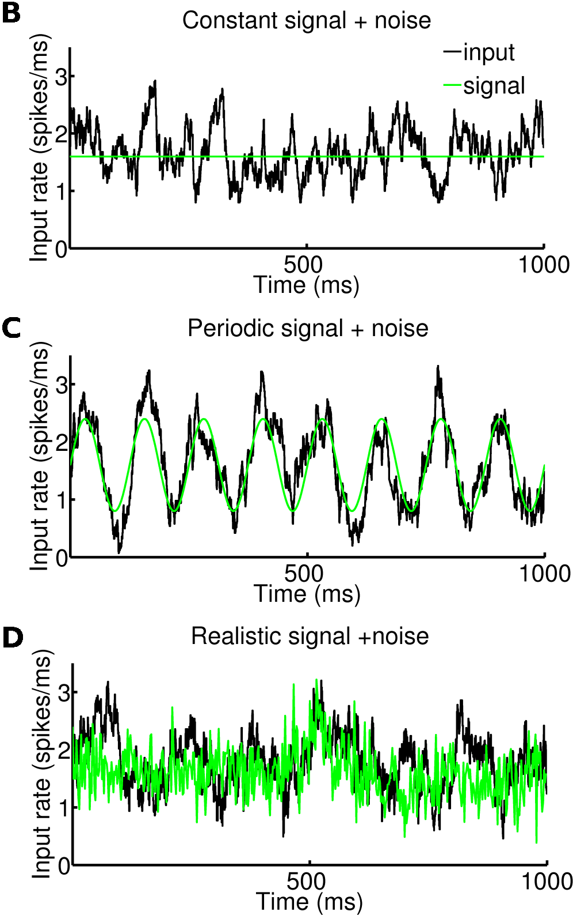

Integrate and fire models of local cortical excitatory-inhibitory networks
I
P
Unspecific
slow
cortical
activity
E
Thalamic input
Leaky integrate and fire neurons 4000 Excitatory Excitatory neurons 1000 Inhibitory Inhibitory neurons.
Sparse (p=0.2) random connections

Slide 14
Integrate and fire models of local cortical excitatory-inhibitory networks
Excitatory SINK
ELECTRODE
Excitatory neurons
Inhibitory SOURCE
Inhibitory neurons
LFP modeled as sum of absolute values of Excitatory and Inhibitory currents on Excitatory neurons

Slide 15
Integrate and fire models of local cortical excitatory-inhibitory networks
Excitatory SINK
Dipole effect: the distance between sink and source creates a dipole
ELECTRODE
Excitatory neurons
Inhibitory SOURCE
Inhibitory neurons
LFP modeled as sum of absolute values of Excitatory and Inhibitory currents on Excitatory neurons

Slide 16
Integrate and fire models of local cortical excitatory-inhibitory networks
Dipoles sum:
Parallel dipoles formed by excitatory neurons sum up linearly
Isotropic dipoles formed by inhibitory neurons sum up to zero over a sufficiently large volume
Excitatory SINK
ELECTRODE
Excitatory neurons
Inhibitory SOURCE
Inhibitory neurons
LFP modeled as sum of absolute values of Excitatory and Inhibitory currents on Excitatory neurons

Slide 17
Integrate and fire models of local cortical excitatory-inhibitory networks
I
P
Unspecific
slow
cortical
activity
E
Thalamic input
Leaky integrate and fire neurons 4000 Excitatory Excitatory neurons 1000 Inhibitory Inhibitory neurons.
Sparse (p=0.2) random connections

Slide 18
Network response
to constant input
input:
costant signal + noise
Inhibitory neurons
spike rate
Excitatory neurons
spike rate
LFP=|I_{Excitatory}|+|I_{Inhibitory}|
on Excitatory neurons

Slide 19
Network response
to constant input
input:
costant signal + noise
Weak synchronization:
Oscillations are not visible in single neurons but only on local field potentials (or total firing rate, that is not accessible to experimenters)
Inhibitory neurons
spike rate
Excitatory neurons
spike rate
LFP=|I_{Excitatory}|+|I_{Inhibitory}|
on Excitatory neurons

Slide 20
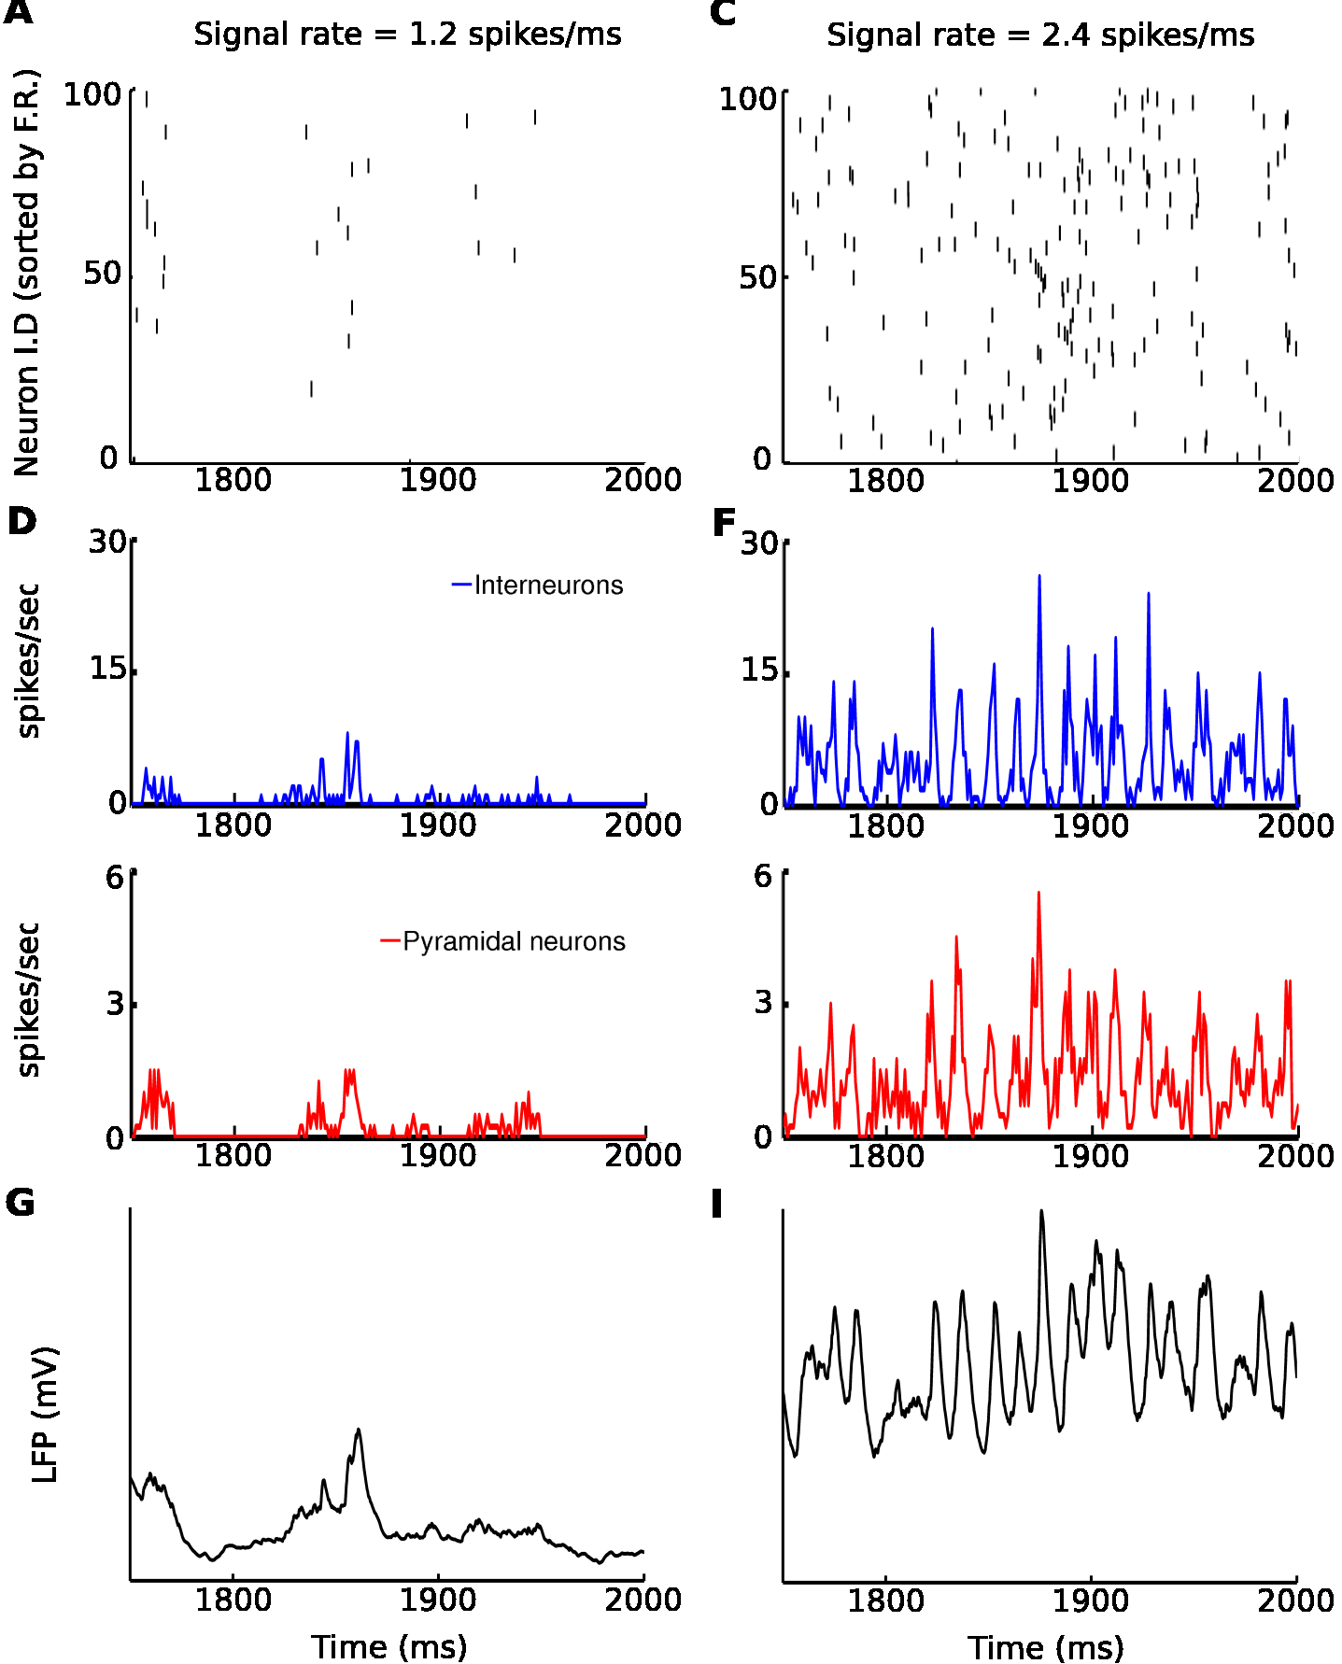
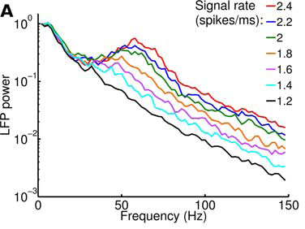
Network response to constant input
Inhibitory neurons
spike rate
Excitatory neurons
spike rate
The network internally generates only gamma-range (40-100 Hz) oscillations
The gamma power encodes the strength of the input
LFP=|I_{Excitatory}|+|I_{Inhibitory}|
on Excitatory neurons
Mazzoni, et al – PLoS Comp Biol (2008)
Mazzoni et al (2010) Neuroimage

Slide 21
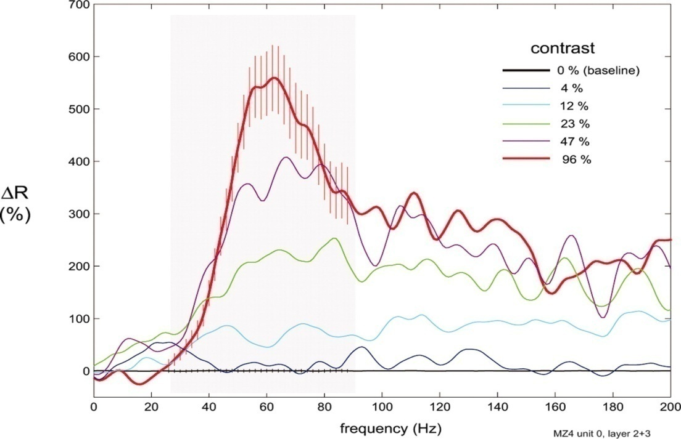
Network response to constant input
LFP from simulated cortical circuit
Modulation of the spectrum of LFP recorded in monkey V1 (Henrie and Shapley
J Neurophysiol 05)

Slide 22
Network response to constant input
Each constant signal is injected 20 times, every time with a different noise. In this way we can compute the information content of the spectrum. Since 8 different rates are injected the total entropy is 3 bits.
information
power
The peak of information is at ~70 Hz, slightly higher than the peak of the oscillations.
The information contained in the frequencies of the gamma band is highly redundant

Slide 23

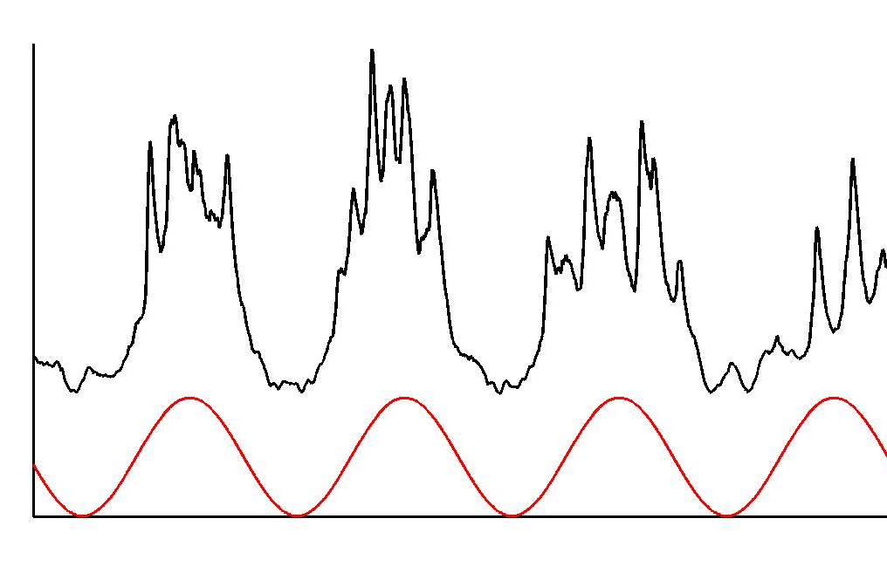
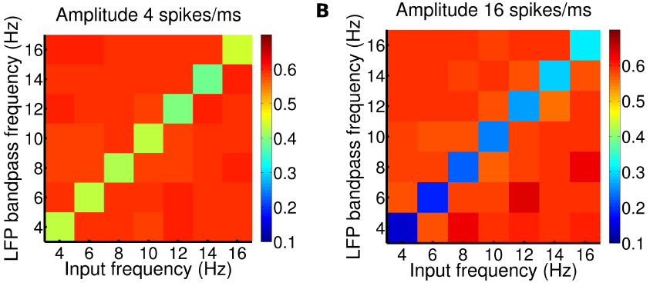
Delta oscillations origin
LFP
Signal
I
P
E
Intuitively: the slower network time constant is given by the dy-sinaptic P-I-P rhythm. Whatever is slower (<30/40 Hz) will not interfere with network rhythms and will entrain the network linearly.
Input

Slide 24
Network response to periodic input
Periodic signals with frequencies ranging from 4 to 16 Hz and 7 different amplitudes are used as input. Each signal is injected with 20 different noises. The total entropy is 5.6 bits.
Periodic signals entrain network LFP oscillations (the effect is stronger for lower frequencies).
Information about the lowest band of the signal spectrum is then contained in the same band of the network LFP.

Slide 25
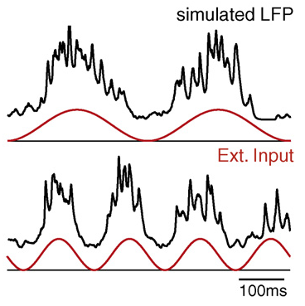
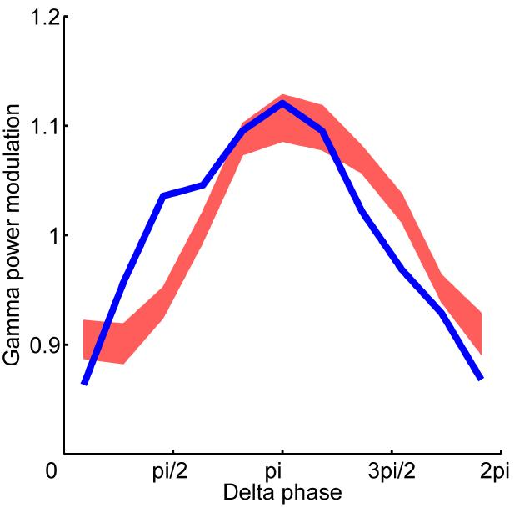
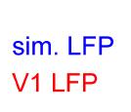
Cross-frequency coupling
The peak of slowly modulated inputs to the network will cause a peak in the low frequency component of the response LFP (because of entrainment) and a particularly high gamma power (because the latter encodes the strength of the input). This will lead to the cross-frequency coupling that is often observed experimentally.

Slide 26
Responses of the simulated network to input stimuli matching LGN spiking activity during naturalistic movies presentations
Stimuli matching LGN spiking activity during naturalistic movies presentations display a broad range of fluctuations.
According to the model, input peaks are associated to troughs in the LFP delta band and to a larger amplitude of the LFP gamma band.
The model correctly reproduces the information content of recorded LFP frequency bands during presentation of naturalistic movies.
Mazzoni et al. (2008)
PLoS Comp. Biol.

Slide 27
Responses of the simulated network to input stimuli matching LGN spiking activity during naturalistic movies presentations
There are two informative bands: frequencies below 10 Hz (”low frequencies”) and 30-100 Hz (gamma band). The two bands convey independent information. Furthermore low frequencies convey independent information from each other, while gamma frequencies are redundant.
Gamma band encodes signal rate
Delta band encodes slow signal components

Slide 28
Take home message(s)
During naturalistic stimulation, primary visual cortex multiplexes information by generating two complementary temporal information streams: slow (<10 Hz) fluctuations of the excitability of the local network, and fast (40-100 Hz) gamma oscillations.
These complementary information channels reflect different aspects of both neural dynamics and of stimulus representations.
Slow fluctuations reflect entrainment to the stimulus time course and thus provide “when” information about stimulus history
Fast oscillations (which are largely redundant to spiking activity) are internally generated by excitatory-inhibitory interactions and encode “what” information about the current stimulus strength

Slide 29
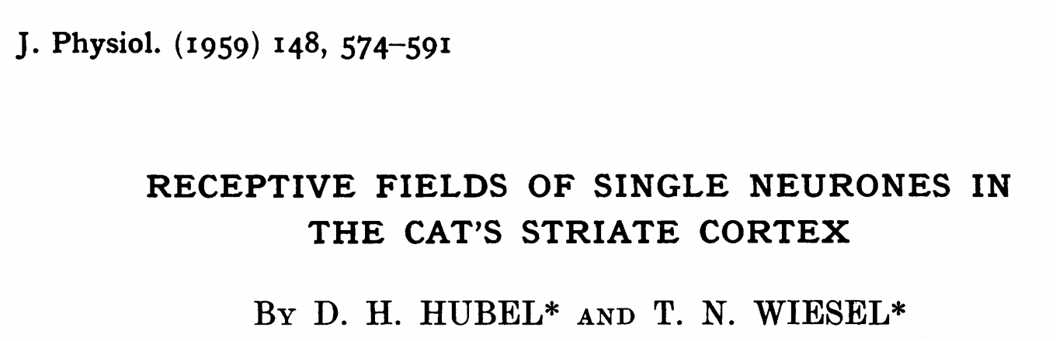
Spike trains encode stimuli
SR
Receptive field of neuron x: sensorial set to whom the neuron is sensitive to (vision, touch)

Slide 30
Single Neuron Variability
Trial 1
Trial 2
Trial 3
Trial 4

Slide 31
Decoding brain activity
???

Slide 32
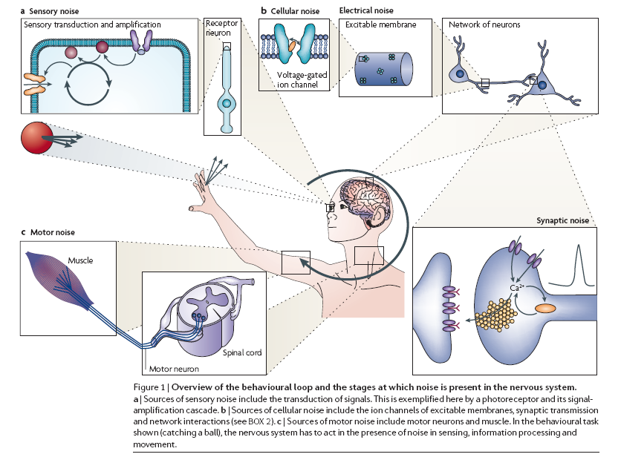
Noise is everywhere

Slide 33
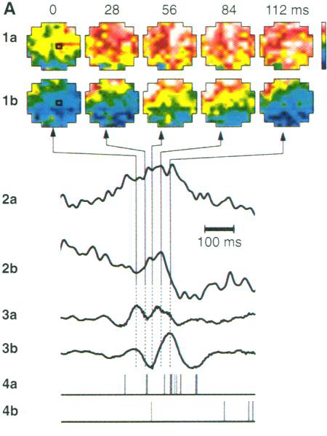
Ongoing activity matters (a lot)
A response to an individual trial can be modeled as a sum of two components: the reproducible response and the ongoing network fluctuations
The effect of a stimulus may be likened to the additional ripples caused when throwing a stone
in a wavy sea
SR
Arieli et al (1996) Science

Slide 34
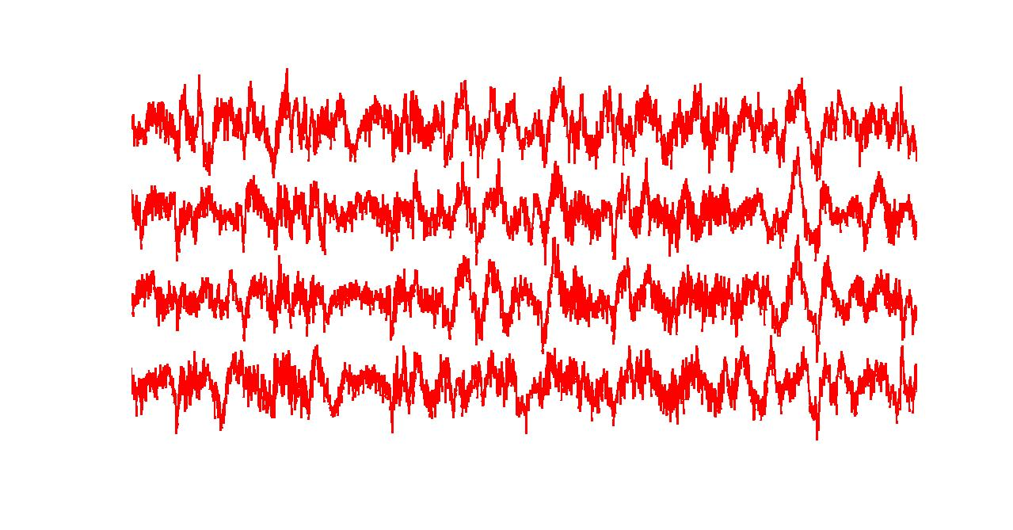
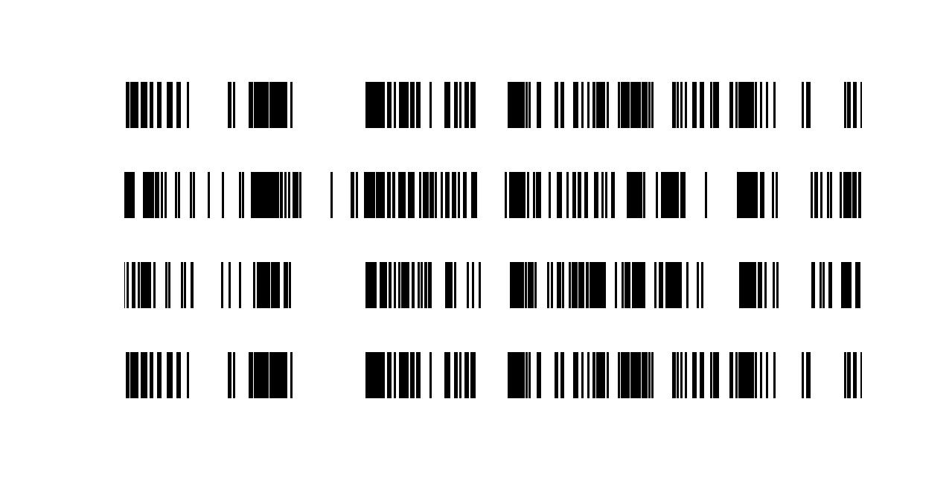
Response to multiple presentations
of the same movie clip
Single unit activity - 10 secs
Local Field Potential - 10 secs
The code must be composed by features that are DIFFERENT from scene to scene and SIMILAR across trials
Notes:
Remember the monkeys

Slide 35
Response to multiple presentations
of the same movie clip
Trial = presentation = repetition =…
Independent presentation of a given stimulus. The larger the number of trials, the better.
Single unit activity - 10 secs
Local Field Potential - 10 secs
The code must be composed by features that are DIFFERENT from scene to scene and SIMILAR across trials
Notes:
Remember the monkeys

Slide 36

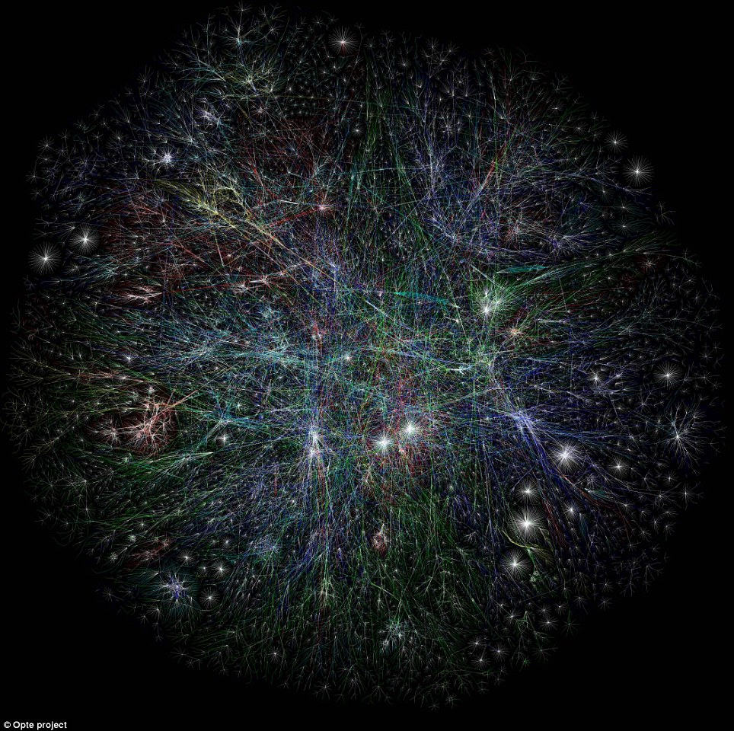
Everything is connected
Internet (in 2005!)

Slide 37
Everything is connected
Watts and Strogatz – Nature 1998
SR
Internet (in 2005!)

Slide 38
Everything is connected… but how much?
Connectivity is a binary feature, correlation is not
Strongly
correlated
Weakly
correlated
Almost
independent
Internet (in 2005!)

Slide 39
Everything is connected… but how much?
Connectivity is a binary feature, correlation is not
Connectivity: there is a link (series) between the nodes A and B
Correlation: the state of A affects the state of B
Strongly
correlated
Weakly
correlated
Almost
independent
Internet (in 2005!)

Slide 40

The relationship between any pair of variables depends on other variables

Slide 41
The relationship between the relevant pair of variables (signal) depends on other variables (noise)

Slide 42
The relationship between the relevant pair of variables (signal) depends on other variables (noise)
Signal = what you are interested in (e.g., sensory stimulation)
Noise = everything else
In a smart experimental design, across different trials, the signal is the same and the noise you dont’know, but likely it is changing.

Slide 43
Correlation does not imply causation
Etc etc etc

Slide 44
Correlation does not imply causation
Correlation can arise from bidirectional and unidirectional links
Correlation can be direct or mediated
Etc etc etc

Slide 45
How to deal with these problems?
First, turn the two variables into a “time series” and estimate the linear correlation.
Time series do not need to track the evolution in time necessarily. It can be any series of states.
$$corr\left(x,y\right)$$
$$=$$
$$\frac{\sum_{t}{(\left(x\left(t\right)−\overline{x}\right)\left(y\left(t\right)−\overline{y}\right))}}{\sqrt{\sum_{t}{{(x\left(t\right)−\overline{x})}^{2}}\sum_{t}{{(y\left(t\right)−\overline{y})}^{2}}}}$$

Slide 46
Estimating the linear correlation
$$corr\left(x,y\right)$$
$$=$$
$$\frac{\sum_{t}{(\left(x\left(t\right)−\overline{x}\right)\left(y\left(t\right)−\overline{y}\right))}}{\sqrt{\sum_{t}{{(x\left(t\right)−\overline{x})}^{2}}\sum_{t}{{(y\left(t\right)−\overline{y})}^{2}}}}$$
Covariance
Standard deviations

Slide 47
Correlation coefficient
All series as a function of time

Slide 48
Correlation coefficient
Series 2 and 3 against Series 1

Slide 49
Correlation coefficient
Test of significance with null hypothesis of getting the same correlation at random
WARNING: DATA SET SIZE

Slide 50
Correlation coefficient
BOOTSTRAP TEST:
You do the analysis with original data and you get your result. You permute at random the data along the variable you want to test. You do it n*20 times. Is the n-th highest value as high as your original result? Is p>0.05?
Test of significance with null hypothesis of getting the same correlation at random
WARNING: DATA SET SIZE

Slide 51
Correlation coefficient and significance
Test of significance with null hypothesis of getting the same correlation by chance
p<0.0000000001 & CC=0.902
p=0.69 & CC=-.075
WARNING: DATA SET SIZE issue

Slide 52
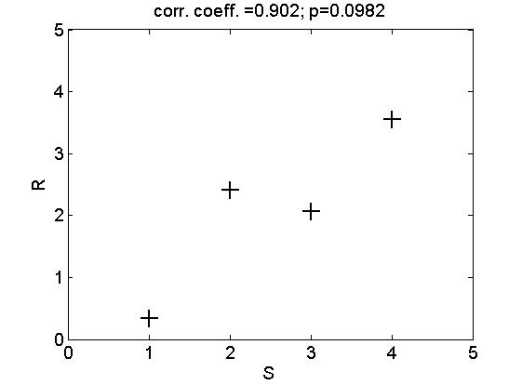
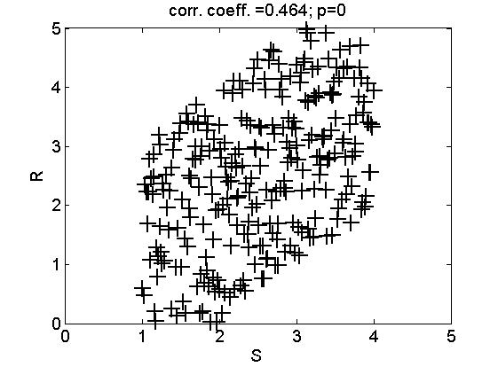
Correlation coefficient and data set size
With small datasets, it’s easy to get a large cc. But this is not informative if p>0.05
With large datasets, it’s easy to get p<0.05. But this is only part of the story if cc is small

Slide 53
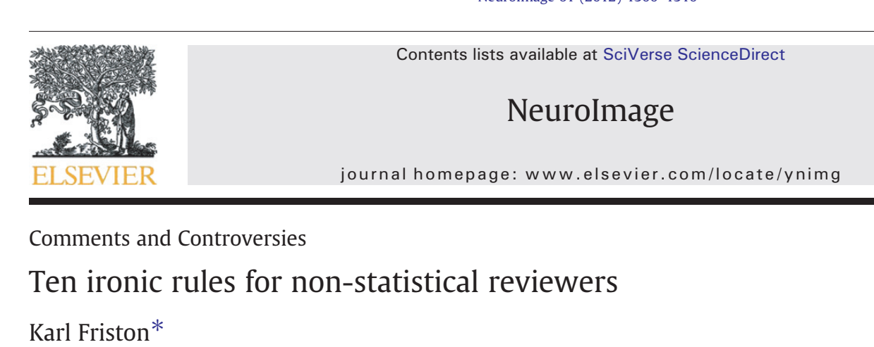
Correlation coefficient and data set size
With small datasets, it’s easy to get a large cc. But this is not informative if p>0.05
With large datasets, it’s easy to get p<0.05. But this is only part of the story if cc is small
SR

Slide 54
Correlation coefficient and data set size
With small datasets, it’s easy to get a large cc. But this is not informative if p>0.05
With large datasets, it’s easy to get p<0.05. But this is only part of the story if cc is small
p <<0.001
Note: cc² is the FRACTION OF VARIANCE of R explained by S, also known as “coefficient of determination”

Slide 55
Cross-correlation
$$crosscorr\left(x,y,d\right)$$
$$=$$
$$\frac{\sum_{t}{(\left(x\left(t\right)−\overline{x}\right)\left(y\left(t−d\right)−\overline{y}\right))}}{\sqrt{\sum_{t}{{(x\left(t\right)−\overline{x})}^{2}}\sum_{t}{{(y\left(t\right)−\overline{y})}^{2}}}}$$
To be used when t does really represent time

Slide 56
Autocorrelation
$$autocorr\left(x,d\right)$$
$$=$$
$$\frac{\sum_{t}{(\left(x\left(t\right)−\overline{x}\right)\left(x\left(t−d\right)−\overline{x}\right))}}{\sqrt{\sum_{t}{{(x\left(t\right)−\overline{x})}^{2}}\sum_{t}{{(x\left(t\right)−\overline{x})}^{2}}}}$$
To be used when t does really represent time

Slide 57


Auto and cross correlation meaning
Autocorrelation
Cross-correlation

Slide 58
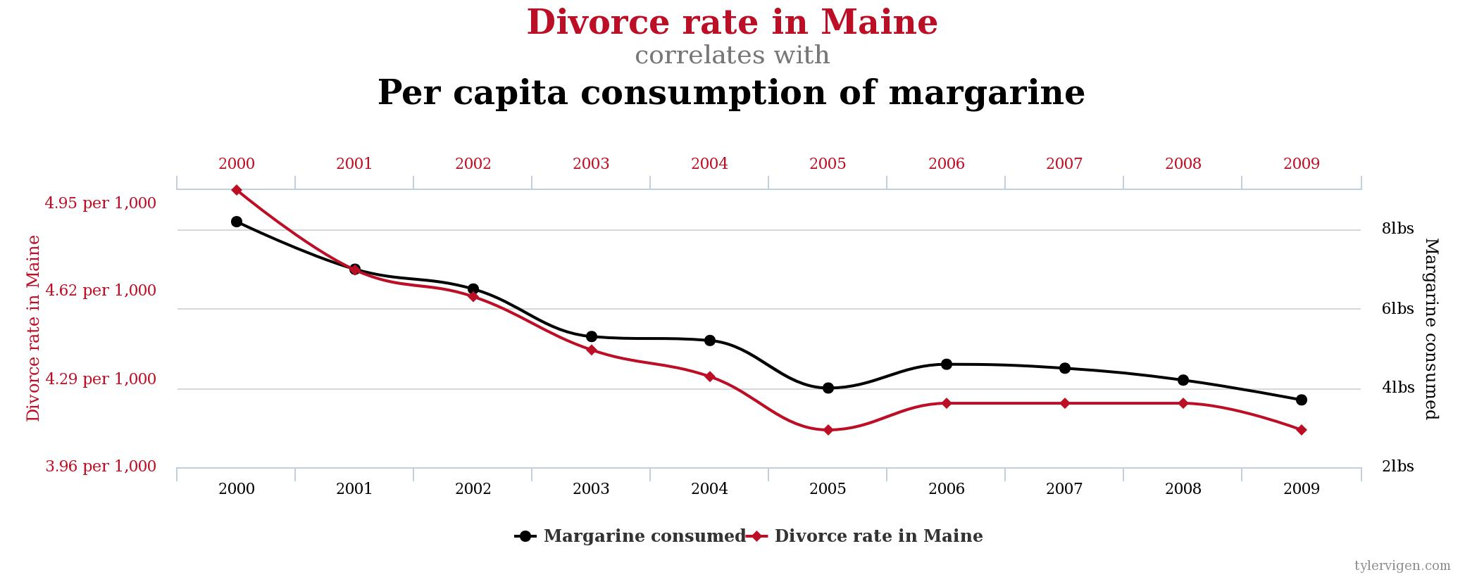
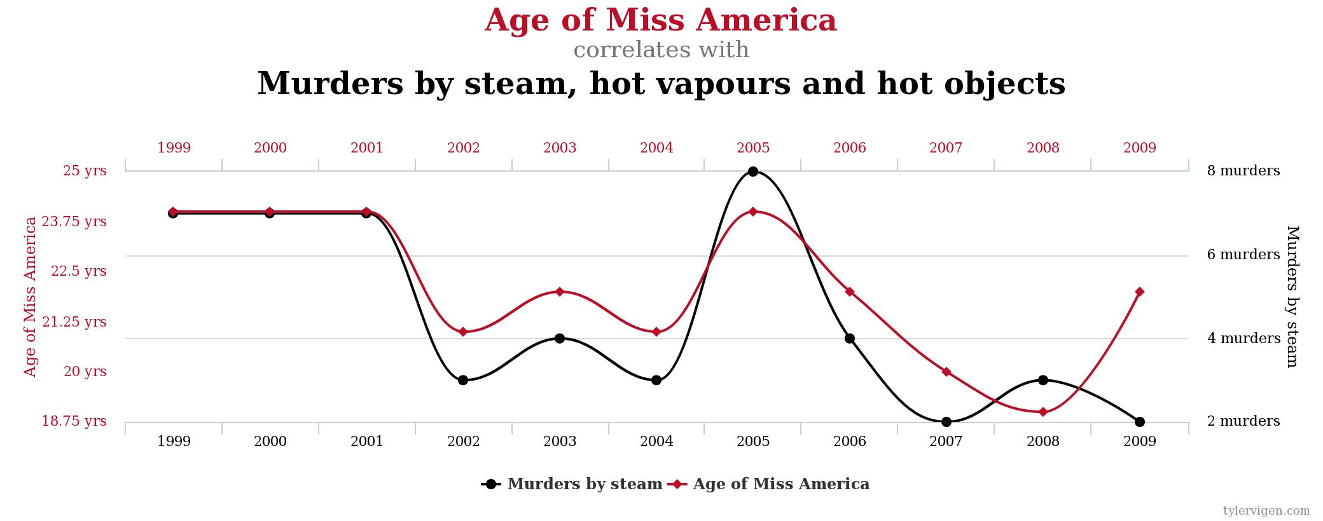
Spurious correlations
R=0.95
R=0.87

Slide 59
Spurious correlations
R=0.95
Meaning:
First you write down your hypothesis, then you compute the correlation. Otherwise you drown in multiple comparisons. Check for multiple corrections (Bonferroni, Tuckey etc)
R=0.87

Slide 60
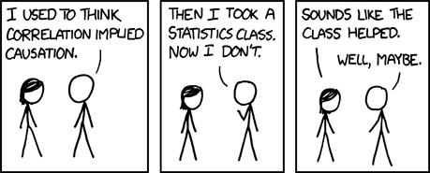
Spurious correlations

Slide 61
Is linear correlation the whole story?
p<0.0000000001 & R=0.902
means related..
…but does p<=0.69 & R=-.075
mean unrelated???

Slide 62
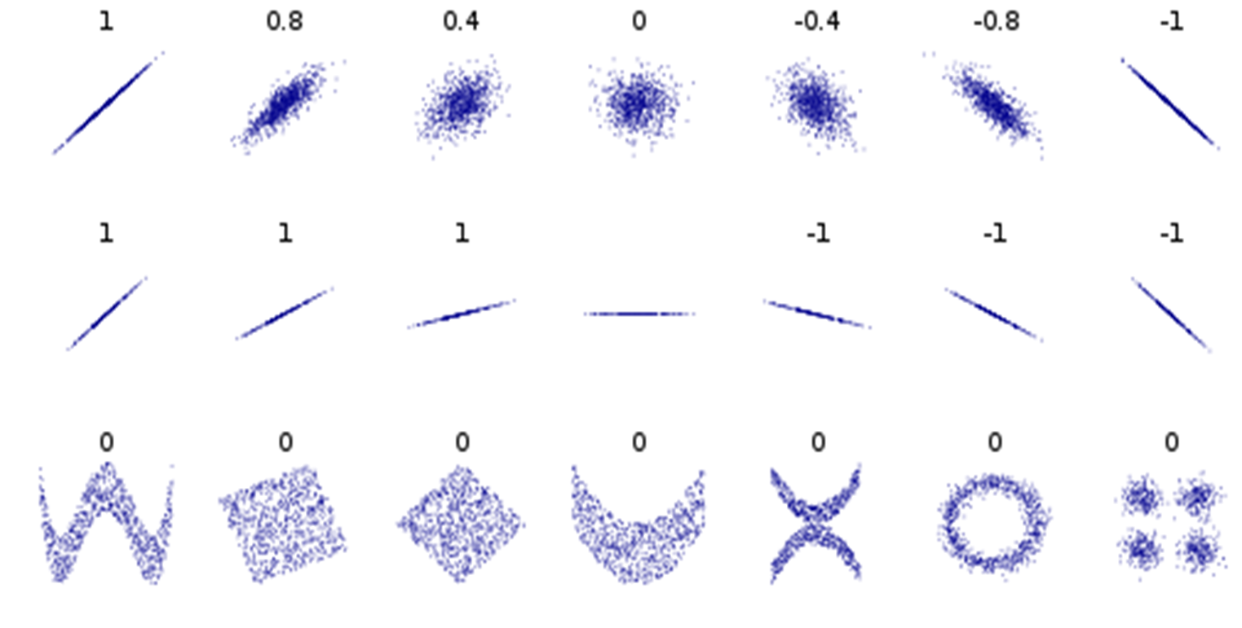
Sometimes linear correlation is not the whole story

Slide 63
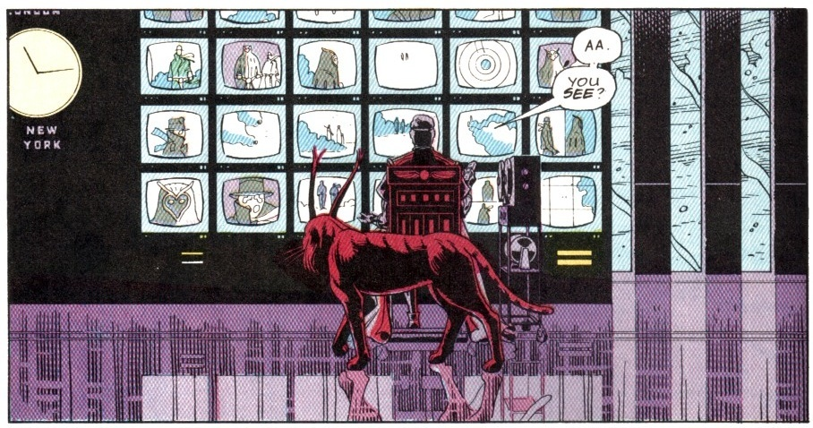
Information
SR

Slide 64
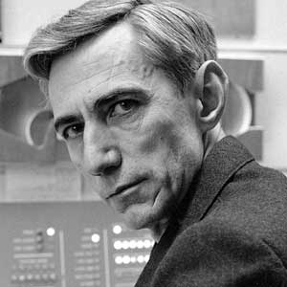
What is Information Theory?
Information theory is a branch of mathematics that deals with measures of information and their application to the study of communication, statistics, and complexity.
It extends the thermodynamic of gas particles to create a “thermodynamic of the symbolic representation”
Based on the pioneering work of Claude Shannon
Shannon, C. E. (1948). A mathematical theory of communication. Bell Sys. Tech. Journal 27:379-423, 623-656.
PE Latham and Y Roudi (2008) Mutual Information – Scholarpedia article (freely accessible)
R Quian Quiroga and S Panzeri (2009) Extracting information from neuronal populations: informaiton theory and decoding approaches. Nature Reviews Neurosci
SR

Slide 65
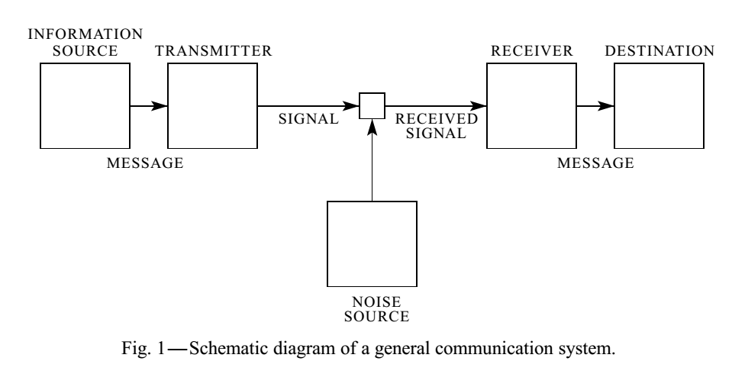
A Mathematical Theory of Communication
It originally arose out of communication theory and is sometimes used to mean the mathematical theory that underlies communication systems and communication in the presence of noise.
Based on the pioneering work of Claude Shannon

Slide 66
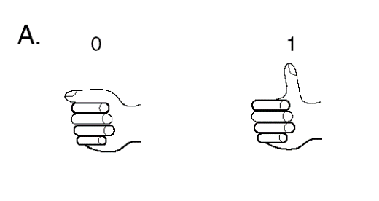

What is a code?
A code is transformation of a certain message by using another alphabet
For example, you can use your fingers to represent numbers
Use only thumb to code 0 or 1
2 fingers are used to encode 3 different numbers by the total amount of extended fingers
2 fingers are used with a more complex code to encode 4 different numbers. Here the position of the extended finger is also used to signal – this increases the capacity to encode information
There are only 10 kind of people in the world: those who know the binary code and those who don’t.

Slide 67
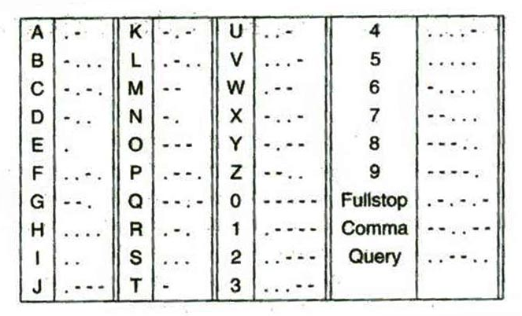
Morse code
Telegrams were transmitted by electrical signals over wires by using Morse codes.
Morse codes are a correspondence between the pattern of electrical signals and the characters of the English alphabet.
There are two types of “symbols”: long (_) and short (.) electrical pulses.
Not only the length of the individual signal is important, but also the timing of the individual signals (> for characters between different words)

Slide 68
Entropy of a random variable S
Suppose we want to gain information about the stimulus
If there is only one possible stimulus, then no information is gained by knowing that stimulus. The amount of information obtained from knowing something is related to its INITIAL UNCERTAINTY
Therefore the first step to define information is to quantify uncertainty.
The entropy H of a random variable s is a simple function of its probability distribution P(s):
H(S) measures the amount of uncertainty inherent to a random variable, i.e. the amount of information necessary to describe it completely.

Slide 69
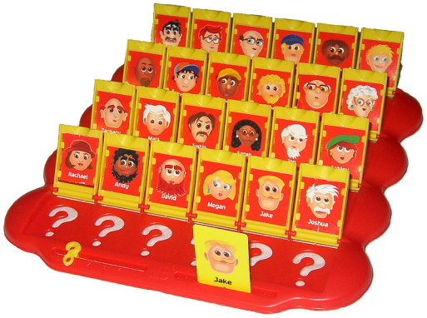
Entropy of a random variable S
Suppose we want to gain information about the stimulus
If there is only one possible stimulus, then no information is gained by knowing that stimulus. The amount of information obtained from knowing something is related to its INITIAL UNCERTAINTY
Therefore the first step to define information is to quantify uncertainty.
The entropy H of a random variable s is a simple function of its probability distribution P(s):
H(S) measures the amount of uncertainty inherent to a random variable, i.e. the amount of information necessary to describe it completely.

Slide 70

One bit = one yes or no question
Thanks to Dr. Miloro

Slide 71
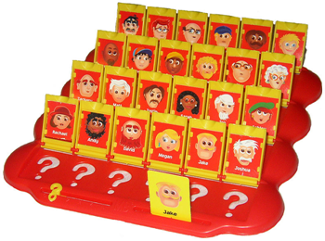
Entropy and description length
H(S) has a very concrete interpretation: Suppose s is chosen randomly from the distribution P(s) , and someone who knows the distribution is asked to guess which was chosen. If the guesser uses the optimal question-asking strategy -- which is to divide the probability in half on each guess by asking questions like "is s greater than .. ?", then the average number of yes/no questions it takes to guess lies between H(S) and H(S)+1.
This gives quantitative meaning to "uncertainty": it is the number of yes/no questions it takes to guess a random variables, given knowledge of the underlying distribution and taking the optimal question-asking strategy
H(Guess Who)=4.585
So you really should win with 5 questions….
Demonstration is left to the audience

Slide 72

Entropy of the stimulus distribution
H(S) expresses the uncertainty about the stimulus (or equivalently, the information needed to specify the stimulus) prior to the observation of a neural response
Residual entropy (equivocation) of the stimulus after observing the neural response
H(S|R) expresses the residual uncertainty about the stimulus after the observation of a neural response.
“Are you a woman?”
P(yes)=5/24; P(no)=19/24;
P(face|no)= 0 or 1/19; P(face|yes)= 1/5 or 0
H(Guess Who|woman)=3.85;
Questions left for optimal strategy: at most 4

Slide 73
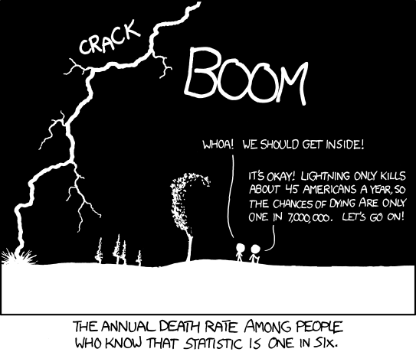
Conditional probability
It is all about the difference between unconditional and conditional
Note: needs more data to be computed

Slide 74
Shannon’s Information
s
r
Shannon’s Information : it quantifies the average reduction of uncertainty (=information gained) after a single-trial observation of the neural response
Measured in bits. 1 bit = reduction of uncertainty by a factor of 2 (like a correct answer to a yes/no question)
I(Guess Who|woman) = 4.58 - 3.97 = 0.61 bits ;
I(Real World|woman) = 1 bit;

Slide 75
Information key equations
R | Stim 1 | Stim 2
Trial 1 | 10 | 5
Trial 2 | 9 | 3
Trial 3 | 8 | 5
Trial 4 | 10 | 4
R | Stim 1 | Stim 2
Trial 1 | 7 | 5
Trial 2 | 5 | 3
Trial 3 | 8 | 5
Trial 4 | 4 | 4
I(S;R) =1 bit
I(S;R) =0.045 bit

Slide 76
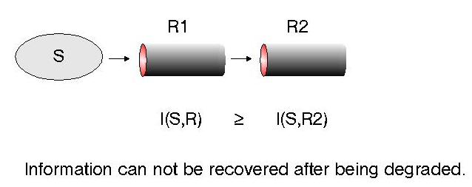
Data processing inequality
this means that you will not increase information by decimating or squaring or taking the logarithm of your data, but does not mean that you can not filter off noise (or extract spikes from raw data) , because
since

Slide 77
Combining different responses
R1 | Stim 1 | Stim 2 | Stim 3
Trial 1 | 10 | 5 | 4
Trial 2 | 9 | 3 | 5
Trial 3 | 8 | 5 | 5
Trial 4 | 10 | 4 | 3
R2 | Stim 1 | Stim 2 | Stim 3
Trial 1 | 3 | 1 | 9
Trial 2 | 1 | 0 | 8
Trial 3 | 0 | 3 | 8
Trial 4 | 2 | 2 | 9

Slide 78
Redundancy
1
1
1.585
R1 | Stim 1 | Stim 2 | Stim 3
Trial 1 | 10 | 5 | 4
Trial 2 | 9 | 3 | 5
Trial 3 | 8 | 5 | 5
Trial 4 | 10 | 4 | 3
R2 | Stim 1 | Stim 2 | Stim 3
Trial 1 | 3 | 1 | 9
Trial 2 | 1 | 0 | 8
Trial 3 | 0 | 3 | 8
Trial 4 | 2 | 2 | 9
Redundancy>0

